Slide 1
Design Patterns
Strategy - Visitor
Yassine KLILICH

Slide 2

Exemple

Slide 3

Exemple

Slide 4

Exemple

Slide 5

Exemple

Slide 6
1 - Chaque employé a un salaire différent

Slide 7
1 - Chaque employé a un salaire different
2 - L'hôpital a différentes façons de payer
le salaire

Slide 8
1 - Chaque employé a un salaire different
2 - L'hôpital a différentes façons de payer
le salaire

Slide 9
L'hôpital peut rémunérer ses employés par :
Virement
PayPal
Bitcoin

Slide 10
abstract class Employee {
public string Nom;
public string Salaire;
abstract public void PayerParVirement();
abstract public void PayerParPayPal();
abstract public void PayerParBitcoin();
}

Slide 11
abstract class Employee {
public string Nom;
public string Salaire;
abstract public void PayerParVirement();
abstract public void PayerParPayPal();
abstract public void PayerParBitcoin();
}

Slide 12
abstract class Employee {
public string Nom;
public string Salaire;
abstract public void PayerParVirement();
abstract public void PayerParPayPal();
abstract public void PayerParBitcoin();
}

Slide 13
abstract class Employee {
public string Nom;
public string Salaire;
abstract public void PayerParVirement();
abstract public void PayerParPayPal();
abstract public void PayerParBitcoin();
}

Slide 14
abstract class Employee {
public string Nom;
public string Salaire;
abstract public void PayerParVirement();
abstract public void PayerParPayPal();
abstract public void PayerParBitcoin();
}

Slide 15
class Docteur {
public override void PayerParVirement() {
Console.Write(“Payer salaire par Virement”);
}
public override void PayerParPayPal() {
Console.Write(“Payer salaire par PayPal”);
}
public override void PayerParBitcoin() {
Console.Write(“Payer salaire par Bitcoin”);
}
}

Slide 16
class Docteur : Employee {
public override void PayerParVirement() {
Console.Write(“Payer salaire par Virement”);
}
public override void PayerParPayPal() {
Console.Write(“Payer salaire par PayPal”);
}
public override void PayerParBitcoin() {
Console.Write(“Payer salaire par Bitcoin”);
}
}

Slide 17
class Docteur : Employee {
public override void PayerParVirement() {
Console.Write(“Payer salaire par Virement”);
}
public override void PayerParPayPal() {
Console.Write(“Payer salaire par PayPal”);
}
public override void PayerParBitcoin() {
Console.Write(“Payer salaire par Bitcoin”);
}
}

Slide 18
class Docteur : Employee {
public override void PayerParVirement() {
Console.Write(“Payer salaire par Virement”);
}
public override void PayerParPayPal() {
Console.Write(“Payer salaire par PayPal”);
}
public override void PayerParBitcoin() {
Console.Write(“Payer salaire par Bitcoin”);
}
}

Slide 19
class Docteur : Employee {
public override void PayerParVirement() {
Console.Write(“Payer salaire par Virement”);
}
public override void PayerParPayPal() {
Console.Write(“Payer salaire par PayPal”);
}
public override void PayerParBitcoin() {
Console.Write(“Payer salaire par Bitcoin”);
}
}

Slide 20
class Infermier : Employee {
public override void PayerParVirement() {
Console.Write(“Payer salaire par Virement”);
}
public override void PayerParPayPal() {
Console.Write(“Payer salaire par PayPal”);
}
public override void PayerParBitcoin() {
Console.Write(“Payer salaire par Bitcoin”);
}
}

Slide 21
class Reception : Employee {
public override void PayerParVirement() {
Console.Write(“Payer salaire par Virement”);
}
public override void PayerParPayPal() {
Console.Write(“Payer salaire par PayPal”);
}
public override void PayerParBitcoin() {
Console.Write(“Payer salaire par Bitcoin”);
}
}

Slide 22
class PaymentService {
public void PayerSalaire(string method, Employee emp) {
if (method == “virement”) {
emp.PayerParVirement();
}
else if (method == “paypal”) {
emp.PayerParPayPal();
}
else if (method == “bitcoin”) {
emp.PayerParBitcoin();
}
}
}

Slide 23
class PaymentService {
public void PayerSalaire() {
if (method == “virement”) {
emp.PayerParVirement();
}
else if (method == “paypal”) {
emp.PayerParPayPal();
}
else if (method == “bitcoin”) {
emp.PayerParBitcoin();
}
}
}

Slide 24
class PaymentService {
public void PayerSalaire(string method, Employee emp) {
if (method == “virement”) {
emp.PayerParVirement();
}
else if (method == “paypal”) {
emp.PayerParPayPal();
}
else if (method == “bitcoin”) {
emp.PayerParBitcoin();
}
}
}

Slide 25
class PaymentService {
public void PayerSalaire(string method, Employee emp) {
if (method == “virement”) {
emp.PayerParVirement();
}
else if (method == “paypal”) {
emp.PayerParPayPal();
}
else if (method == “bitcoin”) {
emp.PayerParBitcoin();
}
}
}

Slide 26
class PaymentService {
public void PayerSalaire(string method, Employee emp) {
if (method == “virement”) {
emp.PayerParVirement();
}
else if (method == “paypal”) {
emp.PayerParPayPal();
}
else if (method == “bitcoin”) {
emp.PayerParBitcoin();
}
}
}

Slide 27
class PaymentService {
public void PayerSalaire(string method, Employee emp) {
if (method == “virement”) {
emp.PayerParVirement();
}
else if (method == “paypal”) {
emp.PayerParPayPal();
}
else if (method == “bitcoin”) {
emp.PayerParBitcoin();
}
}
}

Slide 28
class Program {
public void main() {
Employee doc = new Docteur();
Employee infir = new Infirmier();
Employee recep = new Reception();
}
}

Slide 29
class Program {
public void main() {
Employee doc = new Docteur();
Employee infir = new Infirmier();
Employee recep = new Reception();
PaymentService service = new PaymentService();
}
}

Slide 30
class Program {
public void main() {
Employee doc = new Docteur();
Employee infir = new Infirmier();
Employee recep = new Reception();
PaymentService service = new PaymentService();
service.PayerSalaire(“bitcoin”, doc);
}
}

Slide 31
class Program {
public void main() {
Employee doc = new Docteur();
Employee infir = new Infirmier();
Employee recep = new Reception();
PaymentService service = new PaymentService();
service.PayerSalaire(“bitcoin”, doc);
service.PayerSalaire(“paypal”, infir);
}
}

Slide 32
class Program {
public void main() {
Employee doc = new Docteur();
Employee infir = new Infirmier();
Employee recep = new Reception();
PaymentService service = new PaymentService();
service.PayerSalaire(“bitcoin”, doc);
service.PayerSalaire(“paypal”, infir);
service.PayerSalaire(“virement”, recep);
}
}

Slide 33

class Program {
public void main() {
Employee doc = new Docteur();
Employee infir = new Infirmier();
Employee recep = new Reception();
PaymentService service = new PaymentService();
service.PayerSalaire(“bitcoin”, doc);
service.PayerSalaire(“paypal”, infir);
service.PayerSalaire(“virement”, recep);
}
}

Slide 34


Slide 35

class Docteur : Employee {
public override void PayerParVirement() {
Console.Write(“Payer salaire par Virement”);
}
public override void PayerParPayPal() {
Console.Write(“Payer salaire par PayPal”);
}
public override void PayerParBitcoin() {
Console.Write(“Payer salaire par Bitcoin”);
}
}
WHAT?

Slide 36
class Infermier : Employee {
public override void PayerParVirement() {
Console.Write(“Payer salaire par Virement”);
}
public override void PayerParPayPal() {
Console.Write(“Payer salaire par PayPal”);
}
public override void PayerParBitcoin() {
Console.Write(“Payer salaire par Bitcoin”);
}
}

Slide 37
class Reception : Employee {
public override void PayerParVirement() {
Console.Write(“Payer salaire par Virement”);
}
public override void PayerParPayPal() {
Console.Write(“Payer salaire par PayPal”);
}
public override void PayerParBitcoin() {
Console.Write(“Payer salaire par Bitcoin”);
}
}

Slide 38

Strategy Design Pattern

Slide 39
interface IPaymentStrategy {
}

Slide 40
interface IPaymentStrategy {
public void PayerSalaire(Employee emp);
}

Slide 41
class VirementStrategy : IPaymentStrategy {
public override void PayerSalaire(Employee emp) {
}
}

Slide 42
class VirementStrategy : IPaymentStrategy {
public void PayerSalaire(Employee emp) {
}
}

Slide 43
class BitcoinStrategy : IPaymentStrategy {
public void PayerSalaire(Employee emp) {
}
}
class VirementStrategy : IPaymentStrategy {
public void PayerSalaire(Employee emp) {
}
}

Slide 44
class BitcoinStrategy : IPaymentStrategy {
public void PayerSalaire(Employee emp) {
}
}
class VirementStrategy : IPaymentStrategy {
public void PayerSalaire(Employee emp) {
}
}
class PayPalStrategy : IPaymentStrategy {
public void PayerSalaire(Employee emp) {
}
}

Slide 45
class PaymentContext {
private PaymentStrategy strategy;
public void SetStrategy(PaymentStrategy strategy) {
this.strategy = strategy;
}
public void Payer(Employee emp) {
strategy.PayerSalaire(emp);
}
}

Slide 46
class PaymentContext {
private PaymentStrategy strategy;
public void SetStrategy(PaymentStrategy strategy) {
this.strategy = strategy;
}
public void Payer(Employee emp) {
strategy.PayerSalaire(emp);
}
}

Slide 47
class PaymentContext {
private PaymentStrategy strategy;
public void SetStrategy(PaymentStrategy strategy) {
this.strategy = strategy;
}
public void Payer(Employee emp) {
strategy.PayerSalaire(emp);
}
}

Slide 48
class PaymentContext {
private IPaymentStrategy strategy;
public void SetStrategy(IPaymentStrategy strategy) {
this.strategy = strategy;
}
public void Payer(Employee emp) {
strategy.PayerSalaire(emp);
}
}

Slide 49
class Docteur : Employee {
}
abstract class Employee {
public string Nom;
public string Salaire;
}
class Infirmier : Employee {
}
class Reception : Employee {
}

Slide 50
class Program {
public void main() {
Employee doc = new Docteur();
Employee infir = new Infirmier();
Employee recep = new Reception();
PaymentService service = new PaymentService();
service.PayerSalaire(“bitcoin”, doc);
service.PayerSalaire(“paypal”, infir);
service.PayerSalaire(“virement”, recep);
}
}

Slide 51
class Program {
public void main() {
Employee doc = new Docteur();
Employee infir = new Infirmier();
Employee recep = new Reception();
PaymentContext payment = new PaymentContext();
payment.SetStrategy(new PayPalStrategy());
payment.Payer(doc);
payment.Payer(infir);
payment.Payer(recep);
}
}

Slide 52
class Program {
public void main() {
Employee doc = new Docteur();
Employee infir = new Infirmier();
Employee recep = new Reception();
PaymentContext payment = new PaymentContext();
payment.SetStrategy(new PayPalStrategy());
payment.Payer(doc);
payment.Payer(infir);
payment.Payer(recep);
}
}

Slide 53
class Program {
public void main() {
Employee doc = new Docteur();
Employee infir = new Infirmier();
Employee recep = new Reception();
PaymentContext payment = new PaymentContext();
payment.SetStrategy(new PayPalStrategy());
payment.Payer(doc);
payment.Payer(infir);
payment.Payer(recep);
}
}

Slide 54
class Program {
public void main() {
Employee doc = new Docteur();
Employee infir = new Infirmier();
Employee recep = new Reception();
PaymentContext payment = new PaymentContext();
payment.SetStrategy(new PayPalStrategy());
payment.Payer(doc);
payment.Payer(infir);
payment.Payer(recep);
}
}

Slide 55

class Program {
public void main() {
Employee doc = new Docteur();
Employee infir = new Infirmier();
Employee recep = new Reception();
PaymentContext payment = new PaymentContext();
payment.SetStrategy(new PayPalStrategy());
payment.Payer(doc);
payment.Payer(infir);
payment.Payer(recep);
}
}

Slide 56

class Program {
public void main() {
Employee doc = new Docteur();
Employee infir = new Infirmier();
Employee recep = new Reception();
PaymentContext payment = new PaymentContext();
payment.SetStrategy(new PayPalStrategy());
payment.Payer(doc);
payment.Payer(infir);
payment.Payer(recep);
}
}
BUT !!

Slide 57

Visitor Design Pattern

Slide 58
interface IPayerVisitor {
public void visit(Employee emp);
}

Slide 59
class PayPalVisitor : IPayerVisitor {
public override void visit(Employee emp) {
Console.Write(“Payer salaire par PayPal”);
}
}
interface IPayerVisitor {
public void visit(Employee emp);
}

Slide 60
class PayPalVisitor : IPayerVisitor {
public override void visit(Employee emp) {
Console.Write(“Payer salaire par PayPal”);
}
}
class VirementVisitor : IPayerVisitor {
public override void visit(Employee emp) {
Console.Write(“Payer salaire par cash”);
}
}
interface IPayerVisitor {
public void visit(Employee emp);
}

Slide 61
class PayPalVisitor : IPayerVisitor {
public override void visit(Employee emp) {
Console.Write(“Payer salaire par PayPal”);
}
}
class VirementVisitor : IPayerVisitor {
public override void visit(Employee emp) {
Console.Write(“Payer salaire par cash”);
}
}
class BitcoinVisitor : IPayerVisitor {
public override void visit(Employee emp) {
Console.Write(“Payer salaire par cash”);
}
}
interface IPayerVisitor {
public void visit(Employee emp);
}

Slide 62
abstract class Employee {
public string Nom;
public string Salaire;
public abstract void PayerSalaire(IPayerVisitor method);
}

Slide 63
class Docteur : Employee {
public override void PayerSalaire(IPayerVisitor method) {
method.visit(this);
}
}
class Infermier : Employee {
public override void PayerSalaire(IPayerVisitor method) {
method.visit(this);
}
}
class Reception : Employee {
public override void PayerSalaire(IPayerVisitor method) {
method.visit(this);
}
}

Slide 64
class Program {
public void main() {
Employee doc = new Docteur();
Employee infir = new Infirmier();
Employee recep = new Reception();
PaymentContext payment = new PaymentContext();
payment.SetStrategy(new PayPalStrategy());
payment.Payer(doc);
payment.Payer(infir);
payment.Payer(recep);
}
}

Slide 65
class Program {
public void main() {
Employee doc = new Docteur();
Employee infir = new Infirmier();
Employee recep = new Reception();
doc.PayerSalaire(new CashVisitor());
infir.PayerSalaire(new VirementVisitor());
recep.PayerSalaire(new BitcoinVisitor());
}
}

Slide 66
class Program {
public void main() {
Employee doc = new Docteur();
Employee infir = new Infirmier();
Employee recep = new Reception();
doc.PayerSalaire(new CashVisitor());
infir.PayerSalaire(new VirementVisitor());
recep.PayerSalaire(new BitcoinVisitor());
}
}

Slide 67
Implémentation
Diagramme de Classe
Strategy Design Pattern

Slide 68
Implémentation
Diagramme de Classe
Visitor Design Pattern

Slide 69
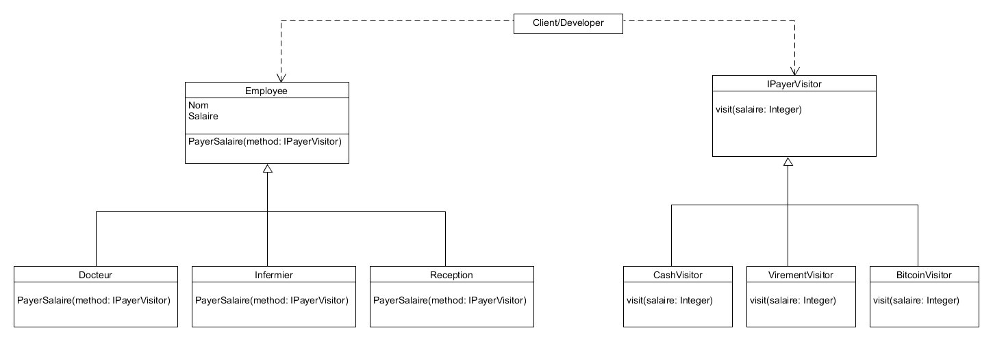

Slide 75
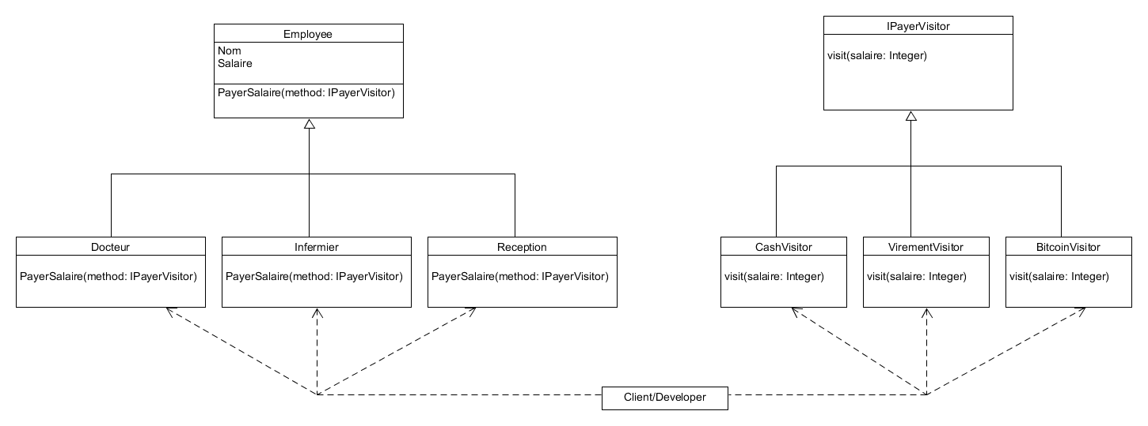

Slide 76
https://www.youtube.com/watch?v=TeZqKnC2gvA

Slide 77


Slide 78


Slide 79


